Slide 1
Title –Prediction of Client Term Deposit Subscription.
By
Pranit Pisal

Slide 2

Objective
The objective is to help in prediction the future deposit subscription clients according to the situation.

Slide 3

Solution
Doing EDA on current dataset.
Using Logistic Regression over the current data.
Analysing the insights and Graph patterns.
Finding out the right patterns.
Checking the values on which the buying of the Term Deposit depends upon.
Choosing the efficient AI model.

Slide 4
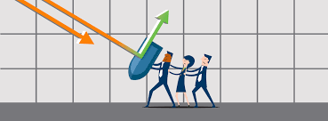

Business Impact
The solution provides help in predicting prediction the future deposit subscription clients according to the situation.

